Slide 1
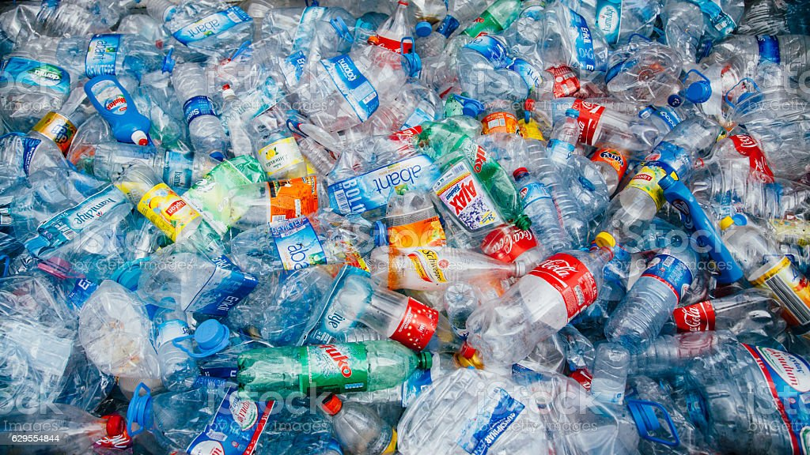
MENVIPRO, 2022
Recycling of Anthropogenic Plastic Wastes
Assoc. Prof. Lili Arabuli
Department of Natural Sciences
School of Science and Technologies
The University of Georgia
Tbilisi, July 11-13

Slide 2
The recycling of technogenic and anthropological waste is the topical issue due to the following reasons: waste create adverse, and frequently hazardous ecological situation in the nature;
by means of their reprocessing is possible to close a deficit in respective marketable production.
Development and implementation of high technologies of reprocessing of domestic and industrial waste is one of the hard-to-solve problems.
Technology of industrial waste reprocessing should satisfy the following requirements: it should be non-waste, environmentally safe and economically profitable.

Slide 3
Among domestic waste the most problematic is industrial, domestic packing and packing for food products (mineral, alcoholic and non-alcoholic beverage).
For manufacturing of this kind of packing are
Used: polyethylene terephthalate, polyethylene, polypropylene and other organic polymers.
After product’s consumption the volume of amortized packing is growing in a large quantities in the environment, and creates adverse ecological situation that causes the necessity of its (as secondary raw material) reprocessing.

Slide 4
Direct copying of the current technologies of waste reprocessing from developed countries to developing ones, namely, in Georgia’s realia is inexpedient and prospectless due to the following reasons:
Current technologies are meant for large-tonnage productions, supply of which with raw materials for developing and small countries is virtually impossible;
Technology and technical equipment are expensive;
Large-tonnage enterprises can’t provide the observation of corresponding environmental standards and frequently create adverse ecological situation both at the enterprise, and on its adjacent territory; For developing countries the technologies designed for low-tonnage production should be considered as prospective.

Slide 5
Their advantages are caused by the accessibility and cheapness of enterprise’s supply with raw materials;
by small quantities of capital investments;
by simplicity of management of production processes and observation of environmental safety standards.
Taking into account all abovementioned the waste recycling method has been proposed by us at the laboratory level as a result of which is possible to get the competitive products highly sought (in-demand) at the local consumer market, and necessary for construction industry – facing, decorative and roof slabs (plates).

Slide 6
By proposed methos of recycling of industrial and domestic plastic waste, as a result of which is determined that on the basis of amortized packing manufactured from polyethylene terephthalate, polyethylene, polypropylene, as well as limestone, tuff, sand, perlites and other mineral raw materials, with the use of simple and low energy-consuming technology is possible to get the high strength (>10-30 MPa) wares (facing, decorative, roof slabs and other materials) highly-sought and saleable in the construction industry.

Slide 7
The getting of extremely high-strength and high-density products is possible in case of the use of sand as filler and binding agent in the amortized packing for food products.
This fact can be explained by the formation of relatively strong bonds between the molecules of binding agent and filler.
Based on the general theory of Lewis and Lux we can suppose that in the melting process takes place activation of alkalinity of hydroxylic groups existing in the molecules of binding agent and acid base interactions.

Slide 8
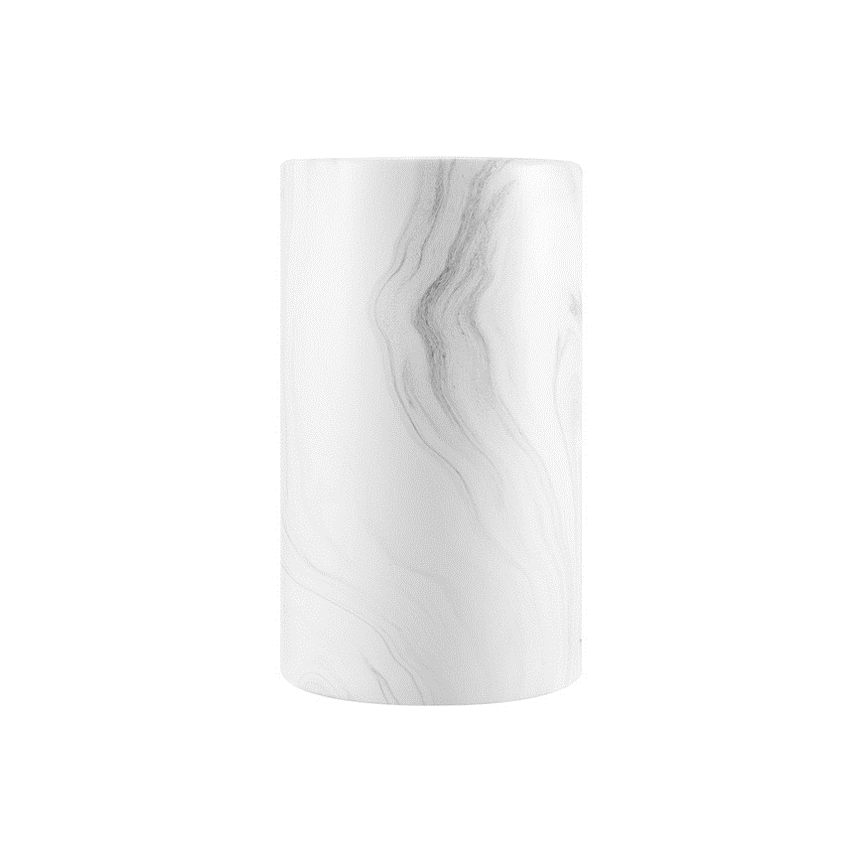
Developed method is implemented in laboratory scale and some characteristics of obtained products are established. Testing of obtained product was carried out on the silicate technology chair of Tbilisi Technical University (Table 1). Analysis of obtained results shows that the offered method of recycling of secondary raw materials (waste) should be considered as prospective.

Slide 9
1 | Monitoring of solid domestic and industrial waste. Arrangement of the line for laboratory researches. Manufacturing of burden constituents, stablishment of optimal parameters of their granulometry, thermomechanical processing, and pressure. Study of mechanisms of interaction between burden constituents
2 | Manufacturing of samples and study of their mechanical, physical and mechanical, and operating characteristics.
3 | Selection, manufacturing and testing of press-forms. Designing, equipment with devices and testing of operational capability of pilot line. Preparation of burden constitutents and manufacturing of articles (wares). Testing and diagnostics of received products on pilot-building site. Producing of project data of the line for industrial applications and drawing up of business-plan

Slide 10
Project innovativeness is directly derived from the conception elaborated by the team of authors, which deals with the problems of reprocessing of secondary solid waste. This conception implies the working out of the technologies that are focused on environmentally safe recycling of solid waste on a scale of low-tonnage productions that is prospective for small developing countries. Copying of respective technology of large tonnage production specific for developed countries is not expedient for small countries because of the following reasons:
they are expensive, require the import of complicated technical equipment;
they are meant for large volumes of raw materials, delivery of which to the large-tonnage production is connected with substantial overhead costs and that will have negative impact on the production prime cost;
none of current technologies eliminates the development of negative ecological situation both at the enterprise and on its adjacent territory. At the same time environmental problem prevention is connected with large capital investments.

Slide 11
Technological novelty of the project is the simplicity of operations for preliminary treatment of component
parts of solid waste burden – grinding, mixing, thermal processing (150-300°C) and pressure, as well as the
possibility of use of received product right after its manufacturing.
Method of mechanical dispersion of particles, granulometric and thermo-mechanical methods will be
basically used in the research for processes of preparation of burden constituents, while for analysis of
received product will be used up-to-date physical and chemical methods (X-ray diffraction method,
differential-thermal analysis, electron microscopy method).
Tasks assigned in the project are simple, easily implemented and there are no expectations of major
complication in the course of their accomplishment.

Slide 12
The analysis of Georgian consumer market showed that the market segment of facing slabs (plates) is filled
with cheap and ecologically hazardous production of China and Turkey. These materials are manufactured
from phenol-formaldehyde resins and on the basis of their modifications, which experience decomposition in the course of time with the formation of toxic substances – phenol and formaldehyde.
Project implementation will make possible the elaboration of effective technology of reprocessing of
domestic and industrial waste. Uniqueness of the worked out technology consists in the fact that it allows us to solve the following problems:
Ecological problem, when occurs safe and non-waste recycling of domestic and industrial waste with the getting of the product, demand for which at the market is relatively high;

Slide 13
Economic problem. On the basis local, cheap and accessible secondary raw material is possible to
produce those marketable products necessary for construction industry, prime cost of which is low and due to this fact its competitiveness at the market is guaranteed. Taking into account today’s heavy social conditions is preferable to timely deliver the cheap, accessible product to the consumer market. It should be also noted that industrial product, proceeding from the properties of its ingredients is distinguished with considerable inertness (inactivity) towards the environment and it is environmentally safe.
It is possible to arrange small enterprises at the territory of Georgia in any average or big city, where are the deposits of filler (quartzite, calcite, tuff, perlite etc.). As to domestic polymer waste, their accumulation is not difficult for any populated place (settlement). Arrangement of small enterprises in the regions of Georgia will make possible to give employment to local population.

Slide 14
After semicommercial-demonstration testing of the processing line will be easy to find corresponding investments, since industrial processing line and simplicity of its technical equipment doesn’t require large
capital investments.
Processing line consists of:
thermomechanical processing – dispersion of the raw materials;
Preparation and briquetting of the burden (furnace charge) in the form of marketable product.
Competitiveness of the product manufactured according elaborated technology and continuous operation of a the enterprise is guaranteed by cheapness and accessibility of the raw materials. Cost of 1 ton of filler varies within the limits of 20-30 GEL, 1 kg of binding agent and amortized packing ~1,5 GEL. According to preliminary calculations, the cost of 1 m² of 8-10 kg slabs (plates) will be equal to 3-4 GEL, approximately.
Minimum energy-consumption – temperature of thermochemical operations doesn’t not exceed 200-250⁰C.
In prospect is possible to offer the elaborated technology to numerically insignificant and developing republics of Post-Soviet space.
Product is valuable from ecological, economic and social viewpoint. The durability (sustainablity) of operation of enterprise according to corresponding technology elaborated in the project is guaranteed due to
two factors:
rising demand of construction industry for ecologically safe facing and decorating slabs;
rising accumulation in the environment of amortized products manufactured from polymer materials and necessity of environmental problem prevention.
Within the framework of the project or after its completion is possible to arrange collaboration with Azerbaijan republic in the sphere of reprocessing of secondary raw materials. There is the verbal arrangement with the Armenian party on the foundation of joint ventures in the region.

Slide 15
Minimum energy-consumption – temperature of thermochemical operations doesn’t not exceed 200-250⁰C.
In prospect is possible to offer the elaborated technology to numerically insignificant and developing republics of Post-Soviet space.
Product is valuable from ecological, economic and social viewpoint. The durability (sustainablity) of operation of enterprise according to corresponding technology elaborated in the project is guaranteed due to
two factors:
rising demand of construction industry for ecologically safe facing and decorating slabs;
rising accumulation in the environment of amortized products manufactured from polymer materials and necessity of environmental problem prevention.

Slide 16
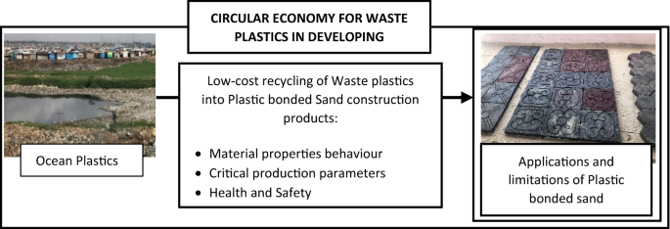
plastic bonded sand properties was in the range between 250 and 325 °C. Higher temperatures reduce material toughness, plasticity, flexural and compressive strengths due to thermal degradation. Lower temperatures produced heterogenous samples with reduced strength due to inefficient mixing. Recycling waste plastics into plastic bonded sand is a resource efficient alternative with significant environmental and public health benefits compared to the existing disposal options in DCs. However, there is a risk of exposure to harmful off gases when plastic bonded sand is produced at temperatures > 250 °C in air. Processing temperature and time need to be controlled. Processing temperatures at ≤ 250 °C under anoxic conditions are recommended to control the off gases due to polymer degradation.

Slide 17
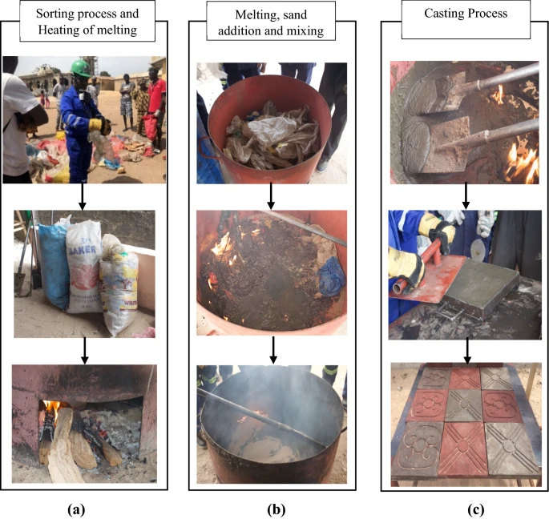
Plastic bonded sand production in The Gambia. The process involves sorting and melting LDPE waste plastics, mixing of sand into molten plastics and casting into steel moulds to form plastic bonded sand paving tiles

Slide 18
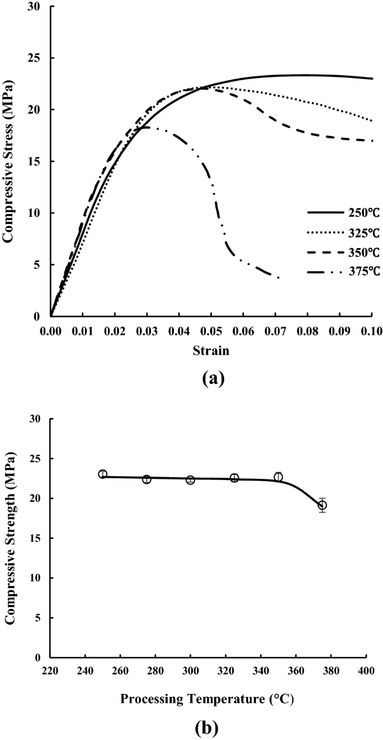
Polyethylene (C₂H₄)_{n} is a non-polar polymer with no functional groups attached to the carbon backbone and is categorised into low-density polyethylene (LDPE) and high-density polyethylene (HDPE). LDPE has high ductility with densities between 0.91 and 0.94 g cm⁻³ and crystallinity between 35 and 55%. HDPE has a density greater than 0.94 g cm⁻³ with higher crystallinity, strength and stiffness compared to LDPE. Water sachets made of LDPE and HDPE bottle caps were used in these experiments.

Slide 19
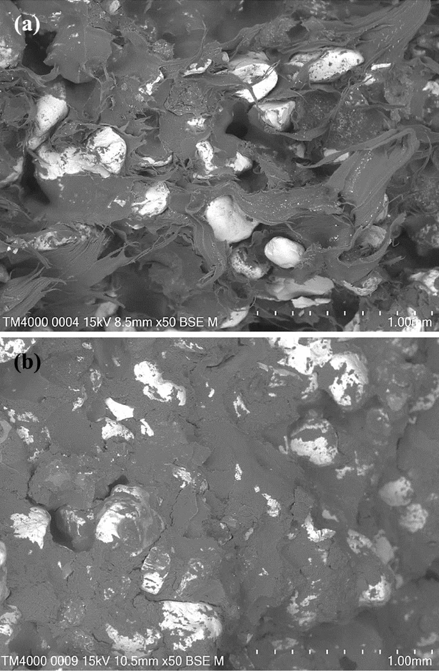

Slide 20
Waste LDPE and HDPE plastics can be used to manufacture plastic bonded sand materials using inexpensive processes with low energy and water requirements. This can provide an important reuse application for waste plastics and particularly in DCs. The processing parameters critical for optimising plastic bonded sand properties for selected construction materials are reported. Plastic bonded sand made with LDPE and HDPE are durable and suitable for use in pavement blocks, roof tiles and partition walls. Optimised samples have maximum compressive strengths that are comparable to C20/25 concrete and significantly higher than sandcrete. They are tough and have higher ductility and thermal conductivities than concrete. The structural arrangement of the thermoplastic binder and aggregate in the composite matrix affects properties. The processing temperature for achieving optimum
plastic bonded sand properties was in the range between 250 and 325 °C. Higher temperatures reduce material toughness, plasticity, flexural and compressive strengths due to thermal degradation. Lower temperatures produced heterogenous samples with reduced strength due to inefficient mixing. Recycling waste plastics into plastic bonded sand is a resource efficient alternative with significant environmental and public health benefits compared to the existing disposal options in DCs. However, there is a risk of exposure to harmful off gases when plastic bonded sand is produced at temperatures > 250 °C in air. Processing temperature and time need to be controlled. Processing temperatures at ≤ 250 °C under anoxic conditions are recommended to control the off gases due to polymer degradation.

Slide 21
plastic bonded sand properties was in the range between 250 and 325 °C. Higher temperatures reduce material toughness, plasticity, flexural and compressive strengths due to thermal degradation.
Lower temperatures produced heterogenous samples with reduced strength due to inefficient mixing. Recycling waste plastics into plastic bonded sand is a resource efficient alternative with significant environmental and public health benefits compared to the existing disposal options in DCs.
However, there is a risk of exposure to harmful off gases when plastic bonded sand is produced at temperatures > 250 °C in air. Processing temperature and time need to be controlled. Processing temperatures at ≤ 250 °C under anoxic conditions are recommended to control the off gases due to polymer degradation.

Slide 22
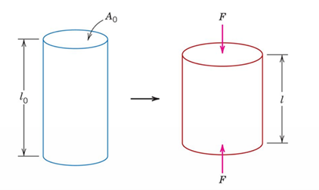
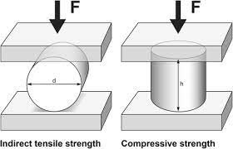
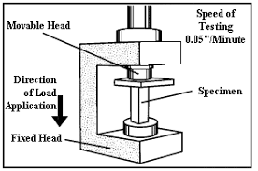
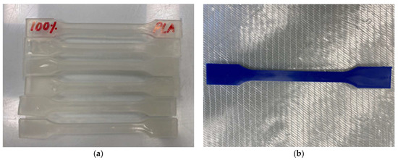

Slide 23
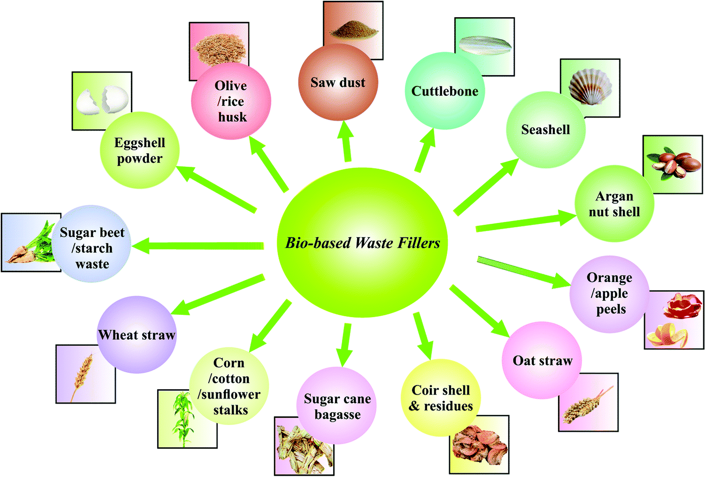

Slide 24
